Slide 1
Malorees Infant & Junior School Offer

Slide 2
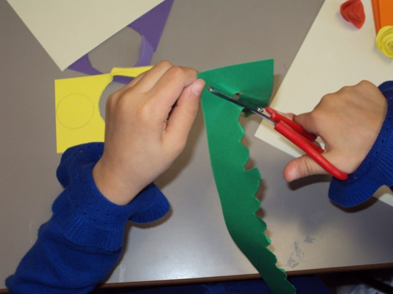
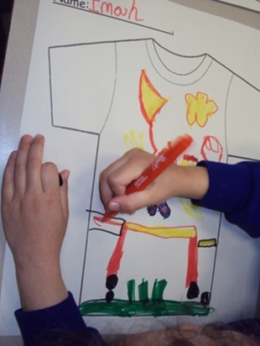
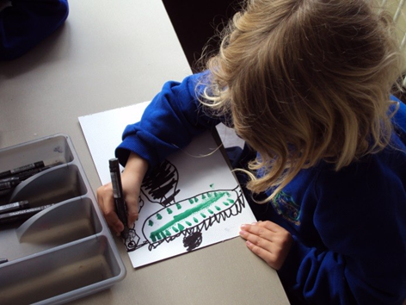
Every child has a different learning style and pace. Each child is unique not only capable of learning but capable of succeeding.

Slide 3
Malorees Infant & Junior School - Offer
Malorees Infant & Junior Schools are fully inclusive schools which work to ensure that all pupils achieve their potential, personally, socially, emotionally and academically in all areas of the curriculum (regardless of their gender, ethnicity, social background, religion, sexual identity, physical or educational needs).
This document is intended to give you information regarding the ways in which we ensure we support all of our pupils including those with SEN and disabilities, in order that they can reach their full potential. It may not list every skill, resource and technique we employ in order to achieve this, as these are continually developed and used to modify our provision to meet the changing requirements of individual children.
Children are identified as having SEN when their progress has slowed or stopped and the interventions and resources put in place do not enable improvement. Once this occurs we have specific needs-based plans and pupil profiles which help support their development and accelerated progress.
Children at Malorees Infant & Junior Schools make good progress and achieve in line with other schools nationally with SEN. Other useful documents such the Disability Accessibility Plan are available on the school website. If you would like further information about what we offer here at Malorees then please do not hesitate to contact us directly.

Slide 4
SEND Practice at Malorees Infant & Junior Schools
Following the guidance as outlined in the SEND Code of practice at Malorees we…
Identify children with SEND and ensure provision is made in accordance with the SEN and Disability Codes of Practice
Have an experienced SEND co-ordinator overseeing the SEND provision.
Invest in whole school and targeted training for staff.
Ensure inclusive teaching and support practice is embedded throughout the school and that all teachers understand that they are ‘Teachers of SEN’.
Provide information on school arrangements for SEND to parents and governors.
Consider pre-emptive (appropriate in advance) arrangements for pupils present and future with a disability.
Publish on the school website the Disability Accessibility Plan.

Slide 5
Who are the best people at school to talk to about my child’s SEND?
In the first instance the people to talk to are:
The class teacher- responsible for;
Planning the curriculum and differentiation and assessing your child’s progress
Personal social development and health education (PSHE)
The teacher in charge of SEND (SENDCo)- responsible for;
Co-ordinating all the support and intervention in the school and keeping parents informed and holding the reviews. Liaising with all agencies involved with your child
The Heads of School - responsible for;
The day to day aspects of the school and all the arrangements for children with SEN. The Head teacher has to report to the Governing Body on all aspects of SEN in the school
The SEND Governor is responsible for;
Making sure the necessary support is made for every child who attends the school with SEN

Slide 6
How will I know how well my child is doing at school?
In order to ensure that parents are fully informed about their child’s progress the school will have:
An open door policy - parents welcome to make an appointment at any time.
A partnership between parents and teachers - we will communicate regularly.
A home school link book to ensure that comments can be responded to.
Regular meetings with SENDCo.
If your child has an EHC plan there will be formal meetings where progress is reported on and a report written.

Slide 7
The Different Types of Support Available for Children at Malorees Infant & Junior Schools
 | Whole school ethos and practice for all children | Support for pupils with additional needs
Autistic spectrum disorders | Structured day Positive behaviour management strategies. Learning style understood. Differentiation. Rewards and sanctions. Communication with parents | Key teacher Small group targeted intervention. ICT used to reduce barriers Alternative communication systems - Makaton. Visual timetable- work stations- noise is minimised Parents involved in learning plan. Advice and intervention from Brent Outreach Autism Service
Speech language and communication | All staff trained in relevant strategies | SALT programmes delivered by TA. SALT Therapist intervention Class based support. Alternative communication systems- Makaton. Social skills group. Talking Partners
Moderate learning difficulties | Differentiation Teaching resources are accessible and appropriate Multi sensory approach to learning Interactive environment and reasonable adjustments | Curriculum is adapted to meet the needs of pupils Targeted intervention programmes Behaviour management plan Social skills group Specific goals- short steps Targeted intervention depending on need

Slide 8
The Different Types of Support Available for Children at Malorees Infant & Junior School
 | Whole school ethos and practice | Support for additional needs
Social, mental and emotional health needs | Identification and assessment in school Additional advice and support from outside agencies Adaptations to curriculum Supported to build relationships and engage Circle time/PSHE curriculum Positive behaviour policy | Interventions are implemented, reviewed and revised Work with parents to refer to CAMHS Targeted intervention to promote social skills and emotional resilience Adaptations to physical environment eg time out Monitoring in unstructured time eg breaks/ lunch
Sensory and Physical needs- hearing/ visual impairment, multi sensory- physical and medical needs | Referrals to Brent hearing impaired service or visual impaired service and provision of specialised equipment. Curriculum is adapted | Targeted intervention and specialist individual therapy programmes eg phonics, physiotherapy, Adaptations to physical environment- enhanced contrast and minimal noise. Compliance with acoustic regulations Disabled toilet facilities Staff consistently use adapted resources and TAs work closely with teachers to support access of the curriculum Assistive technology eg hearing aids and ICT software

Slide 9
In addition
All children will have | The following provision
Opportunities for parents and child to meet with class teacher prior to entry | The Equality Act 2010 requires schools to ensure that SEND children are not disadvantaged
Emotional and social needs addressed | Support from in school or outside agencies
Progress tracked and reviewed | Plans, assessed, reviewed, adjusted, tracked
Transition arrangements | Access to transition programmes and visits
Provision that is assessed and evaluated | Whole school policies are evaluated and monitored
Access to mainstream facilities and extra curricular activities whenever possible | Children are included with mainstream peers unless there is a planned intervention
Progress that is shared with parent/carers | Parents are informed and actively encouraged to support shared goals at home

Slide 10
What happens if my child with SEN makes very little progress at school?
Where a child with SEND continues to make little progress despite the support provided by the school’s SEND provisions including external support and advice, and there is evidence that the child has severe and complex needs that cannot be met within the resources
ordinarily available to school, we will ask the Local Authority to undertake a statutory assessment of the child’s SEND either as set out in the SEND Code of Practice or through a request for an Education Health and Care Plan.

Slide 11
If you need to complain
Parents have the following rights of redress, should the school, Governors or LA fail in it’s duty to provide, or if the parent disagrees with a decision or feels that there is discriminatory practice:
The school or LA complaints procedure
An appeal to The SEN and Disability Tribunal (LA decision)
A claim against the responsible body (Chair of Governors or LA) for disability
To the SEN and Disability Tribunal for discrimination
A complaint to the LA Ombudsman (Schools and LAs)

